Slide 1
Measuring Astronomical Distances
Sydney Sherman
2nd Year Graduate Student
Department of Astronomy
University of Texas at Austin

Slide 2
What is the expansion rate?
How do we measure it?

Slide 3

Cosmological Distance Ladder
Distant Galaxies
Distant Stars That Explode Predictably (Type Ia Supernovae)
Distant Stars That Vary Predictably (Cepheid Variables)
Stars Near The Solar System
Sun
Earth
Notes:
-Without knowing the distances to objects, we would be left with a very 2D picture of the universe

Slide 4


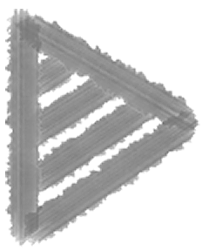
The Ancient Universe
Stars and other “heavenly bodies” move on transparent spheres
The Earth is the center of the universe
Need some creative geometry for this to almost work
Aristotle 350 BC
You can be much less creative with geometry if the Sun is the center of the solar system
Copernicus 1473 - 1543
Notes:
-In fact, that 2D view was considered correct for many years
-Many tried and failed to measure the distance to the celestial sphere

Slide 5
The Ancients Had Trouble With Parallax
Stellar Parallax = The apparent motion of foreground stars relative to background stars
July
January
January
July
Notes:
-Turns out that even Aristotle had good reason for believing that the geocentric model is correct…he was not able to observe parallax
-Copernicus also tried but failed to observe parallax

Slide 6

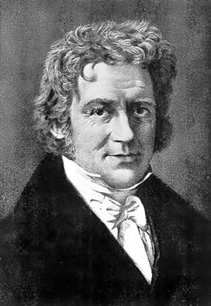
First Parallax Measurement
Measured by Friedrich Wilhelm Bessel in 1838
Determined that the star 61 Cygni has a parallax of 0.314” or ~700,000 AU
The true value is 0.287”, but Bessel got pretty close!
Notes:
-wasn’t until 1838 that the first confirmed measurement of parallax was done
-A few months later, a parallax was measured for alpha Centauri was published. This nearly won the award for closest star (and easiest to measure with parallax) but then proxima centauri was found

Slide 7
How Useful is Parallax?
1 AU
θ
d
If θ = 1”, then d = 206,265 AU = 1 Parsec
As the parallax angle gets smaller and smaller, errors dominate the measurement
Parallax cannot be measured beyond a few hundred parsecs
Notes:
-At theta = 0.01” you can’t distinguish between the true motion of a star and fluctuations in the Earth’s atmosphere

Slide 8
Outside Our Neighborhood
Brighter stars are not necessarily closer than fainter stars
Need some way to relate apparent magnitude (a measured quantity) to absolute magnitude (a physical property)
Reminder about the astronomical magnitude system:
m
a few hundred pc
M
10 pc

Slide 9

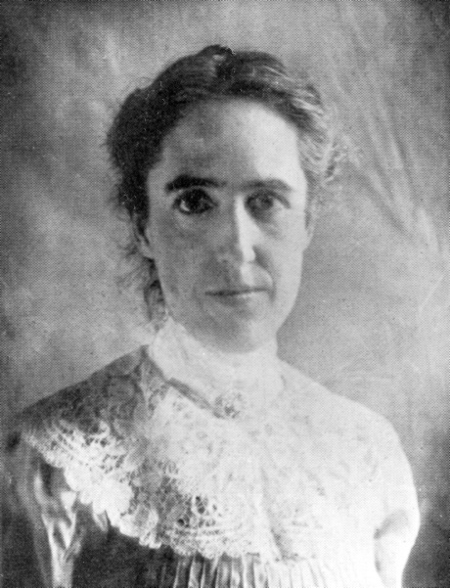

Cepheid Variables
In the early 1900’s Henrietta Swan Leavitt began studying variable stars at Harvard
She found the relationship between the period of variation and the luminosity of the star
Leavitt’s Law
Absolute Magnitude
Period
Notes:
Women in the early 1900s were not allowed to operate telescopes, so they were the barely paid human computers
Levitt was measuring stars in the SMC when she noticed the trend between luminosity/absolute magnitude and the period

Slide 10

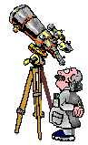


Distance to Cepheids
Use Leavitt’s Law
Convert observed period into absolute magnitude (M)
Observe
Period of variability
Apparent magnitude (m)
Find Distance
Relate absolute magnitude and apparent magnitude to calculate distance
m - M = 5log(d) - 5
M
P
Notes:
Using Leavitt’s law and a little patience while you take measurements of the period, you can easily get a reliable distance
This method works both inside our galaxy and for other galaxies that have bright, luminous stars

Slide 11

Type Ia Supernovae
The ultimate standard candle!
Brighter than cepheids
Easily found in distant galaxies (out to 1 billion Parsecs)
Very reliable luminosity
Relate known luminosity, apparent magnitude, and distance
Downside: They cannot be predicted

Slide 12

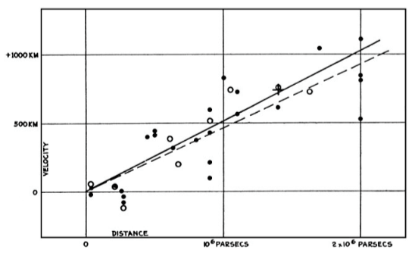

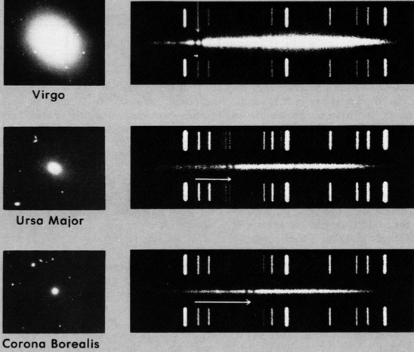
Distances to Everything Else
In 1920, Edwin Hubble noticed a clear relation between the recession velocity of galaxies and their distances
recession velocity = H0 * distance
Hubble studied the spectra of galaxies and found their distance using the doppler shift in their spectral lines
Notes:
Hubble did this with spectra, but this can also be calibrated (and has been refined) using cepheids and Type Ia supernovae
Calcium H and K lines

Slide 13

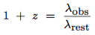
Spectroscopic Redshifts
Use software to locate easily identifiable emission/absorption lines
Use observed wavelength and expected wavelength to determine redshift
This is very expensive!
z = redshift

